Slide 1
Emily Pearse & Ruth Pearse
(CEO Parenting Special Children)
Supported Living

Slide 2

Learning skills for the future
Aspirations & choice
Why I wanted to go to Foxes Academy?
Learn to live independently
Similar experience to others who were going to university/college
Gain a qualification that would help her with a paid job in hospitality

Slide 3
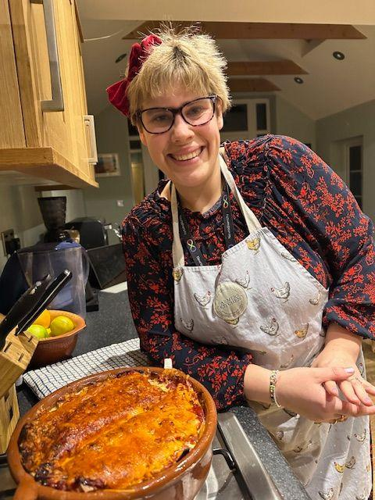
What skills did you learn from Foxes that have helped you live in your own home?
Budgeting
Planning & cooking healthy food
Cleaning & tidying
Shopping
Travel
Time keeping
Customer service

Slide 4
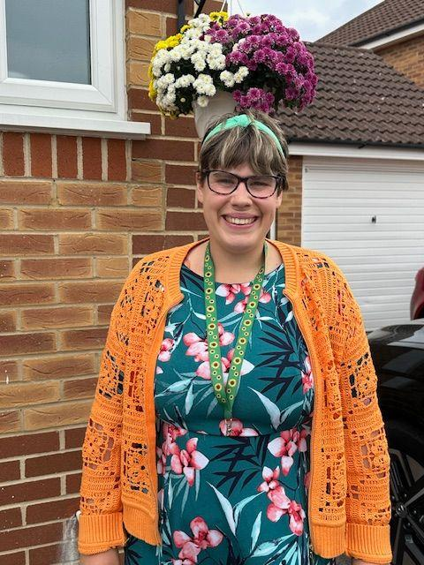
What is it like living in supported living? What do you enjoy?
Independence
Having my own home
Having time with my friends
Putting into practice the skills I learnt at Foxes
What has been difficult? Living with other people, leaving home

Slide 5

Preparing for Adulthood and beyond, it is holistic
Preparing for Adulthood: Independent living | NDTi

Slide 6
Our journey
Transition to adulthood reviews 14+
19+ Application specialist catering & hospitality residential college
Skills & qualifications
ready for employment
25+
Ongoing learning/courses
Aspirations
Fulfilling life
Age 17- 19 local specialist college &
work experience
Age 19-22
Foxes Academy
Age 22-25+
Employment &
Volunteering
25+
Supported living
Social activities

Slide 7
Preparing for supported living - choice is key for young adult
Different options for supported living - do your research
Inform your local authority that your young adult would like to move to supported living, residential care, Shared Lives
Have a social care needs assessment
Ensure you have Power of Attorney post 18 or deputyship
See what benefits are needed, Universal Credit, PIP/DLA
Refer to the Care Act 2014 when needed
Options for supported living | Disability charity Scope UK

Slide 8
Top tips when looking for housing - choice & research
Think about whether you want/need to live alone or with other people and with whom
Think about where you would like to live - you need to feel safe, transport links, near to family or familiar place
Look at different providers, especially important for care package, CQC reports, LA preferred providers
Top-Tips-SEND-Housing.pdf

Slide 9
Our experiences
Key factors for daughter and for us as parents - CHOICE
Who daughter shared a house with or didn’t
Safe, welcoming home, clean, well decorated
Support company - CQC (Care Quality Commission) reports, training, working in partnership with us, prior visits
Activities to enable her to live a fulfilling life
Being mindful of changes in behaviours
It might not work so being open to planning something different

Slide 10
Transition is difficult
For adult - particularly if autistic - do they need phased transition
For parent/carers - letting go, we know our adult best how much do we get involved, what feedback do we need
Partnership working key - you are not being over protective! Be proactive
It is an ongoing process, life throws curve balls which can impact on supported living

Slide 11
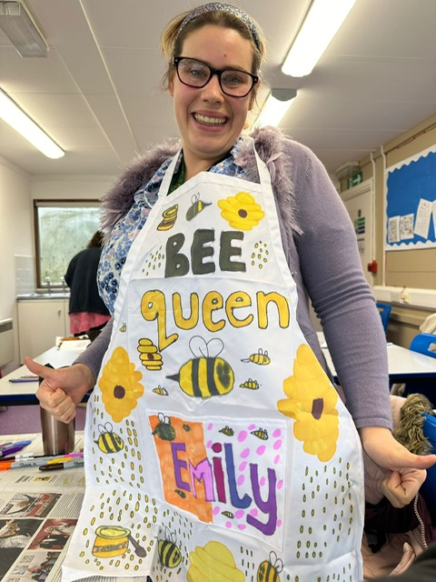
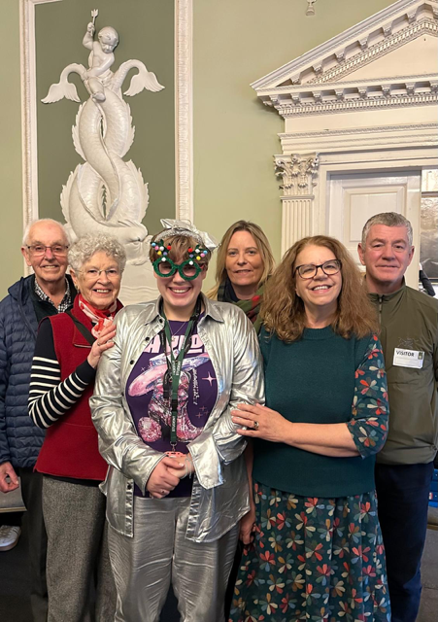


Slide 12
Resources - National
Learning Disability - Independent Living - Housing | Mencap Easy Read
Independent living & housing | Contact
Preparing for Adulthood: Independent living | NDTi
Options for supported living | Disability charity Scope UK
Supported Living Framework list - Reading Borough Council
Care Quality Commission
Tackling Financial Insecurity Together | Turn2us
Care Act 2014

Slide 13
Resources - local
Stepping Forward | DISABILITY • RIGHTS • ACTION - benefits advice
Reading Mencap - The Local Voice of Learning Disability
Get help from the Berkshire Adult Autism Support Service - Autism Berkshire
Reading Directory | Transition - Becoming an adult and preparing for the future
Adult Social Care and Public Health - Reading Borough Council

